Slide 1





SPA with AJAX and Kinvey
Creating Single Page Apps (SPA) with jQuery AJAX, REST and Kinvey
SPA with AJAX and Kinvey
AJAX
REST
SoftUni Team
Technical Trainers
Kinvey
Software University
http://softuni.bg

Slide 2



Table of Contents
The Book Library App
Kinvey Back-End
App Skeleton: HTML + CSS
Session / Local Storage
App Code Structure
Login / Register / Logout
CRUD Operations

Slide 3
Have a Question?
sli.do #JSCORE

Slide 4
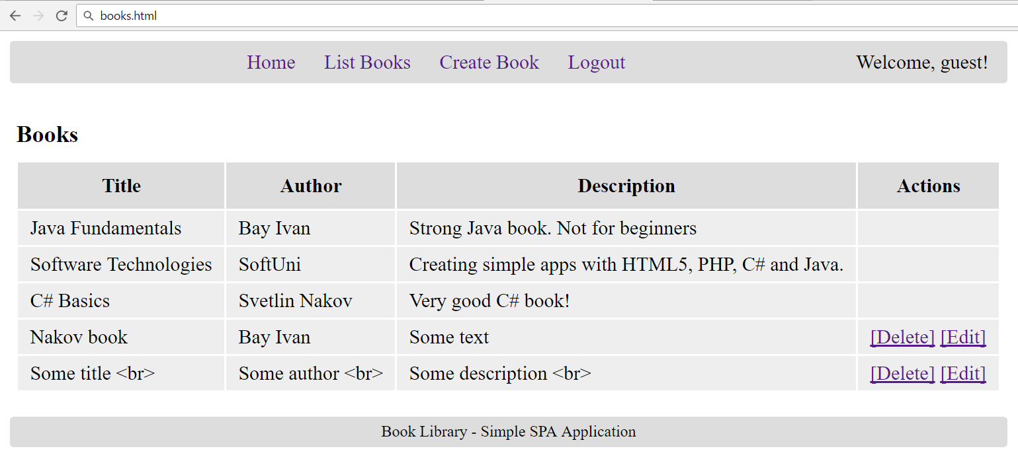
The Book Library Project
Book Library: CRUD + Login / Logout

Slide 5
The "Book Library" App
Design and implement a “Book Library” front-end single-page application (SPA) in HTML5 with REST back-end in Kinvey
Books have title, author and description
Implement the following functionality:
Login, register, logout, list all books, create a new book, edit existing book, delete existing book
Books have ownership:
Anyone can view all the books
Only the book creator can edit / delete his own books

Slide 6
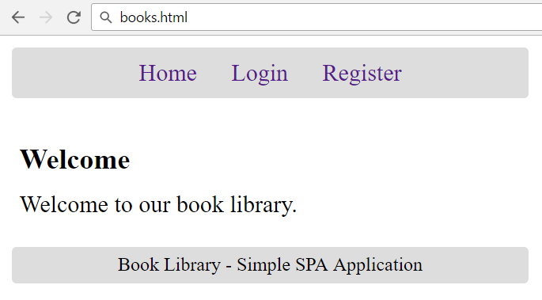
Home Screen

Slide 7
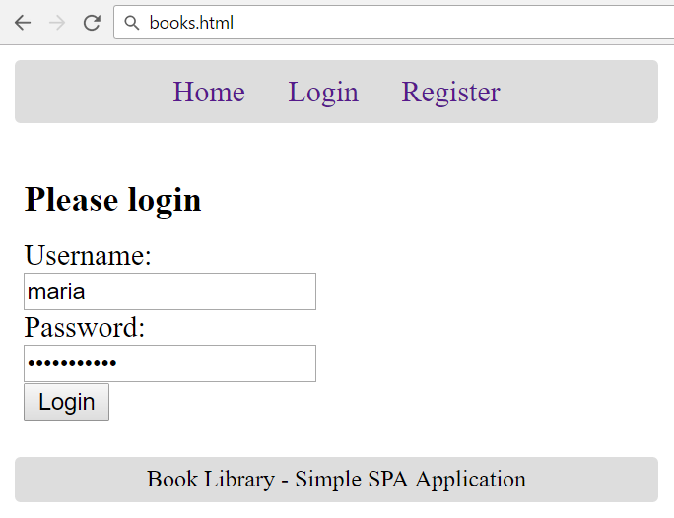
Login Screen

Slide 8
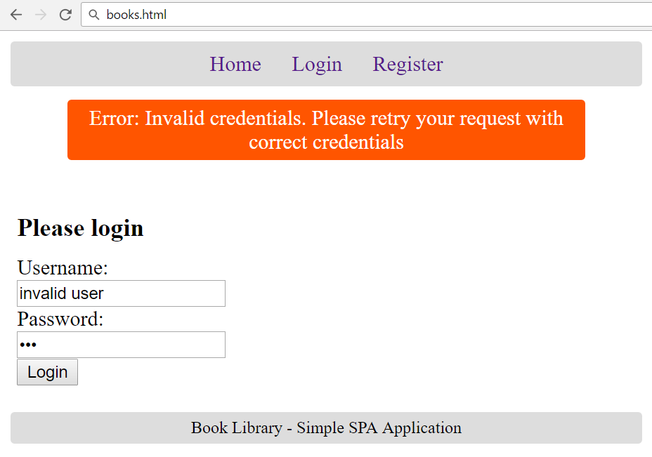
Login Screen: Invalid Login

Slide 9
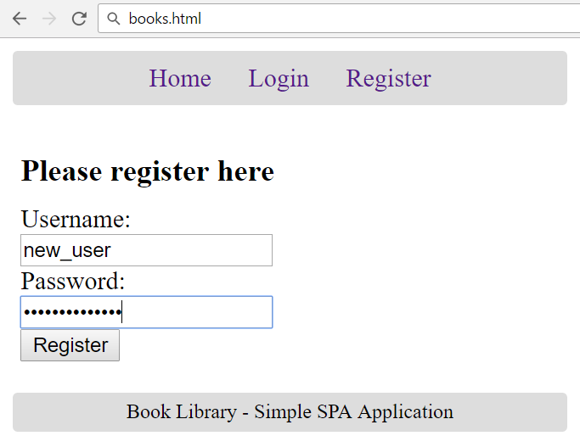
Register Screen

Slide 10
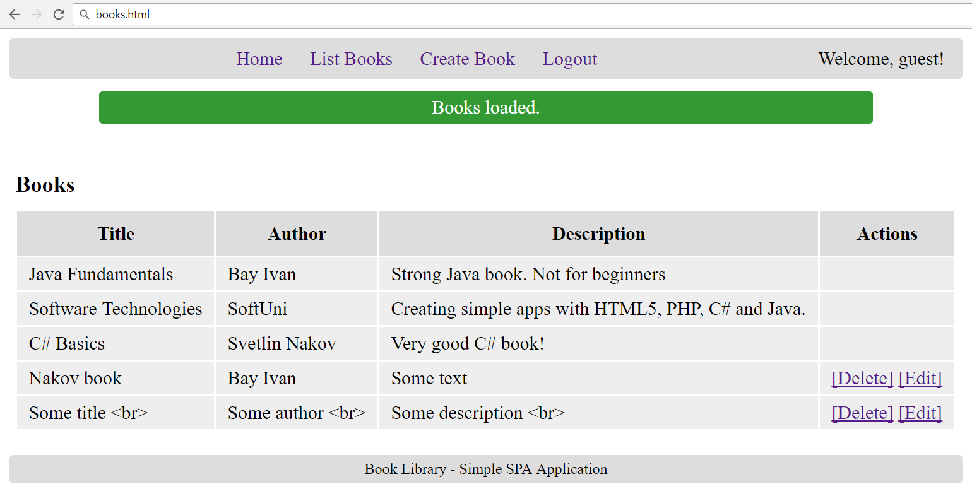
List Books Screen

Slide 11

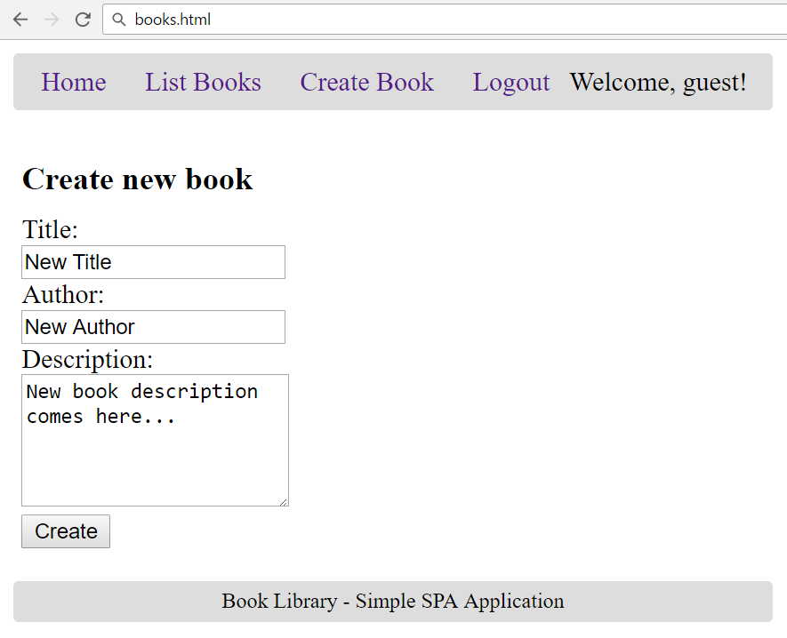
Create Book Screen

Slide 12
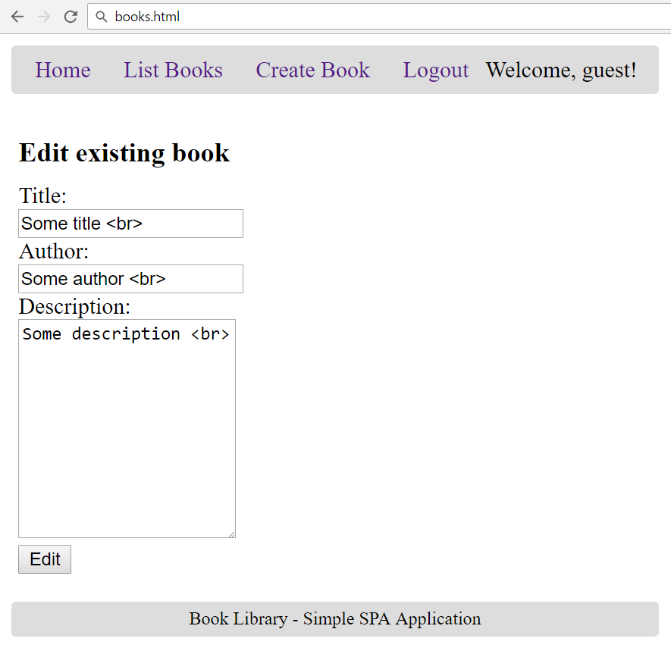
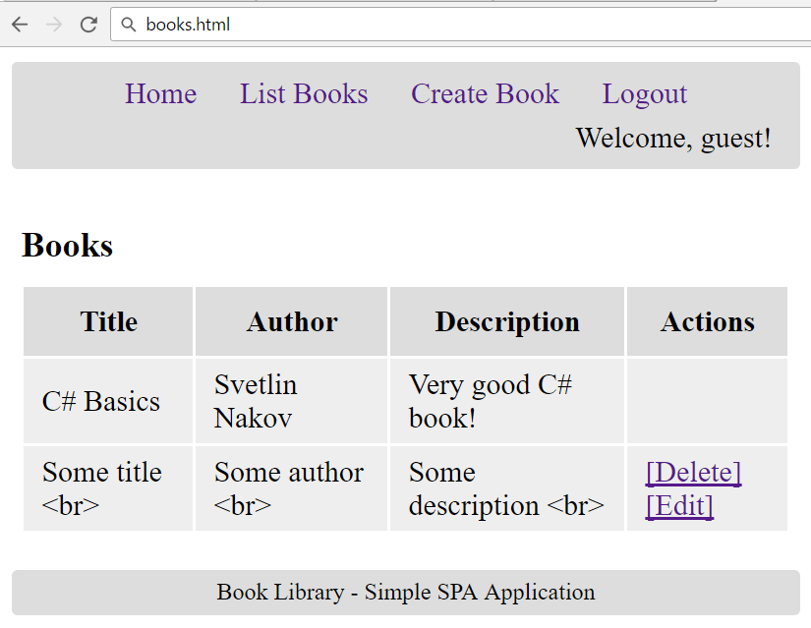
Edit Book Screen

Slide 13
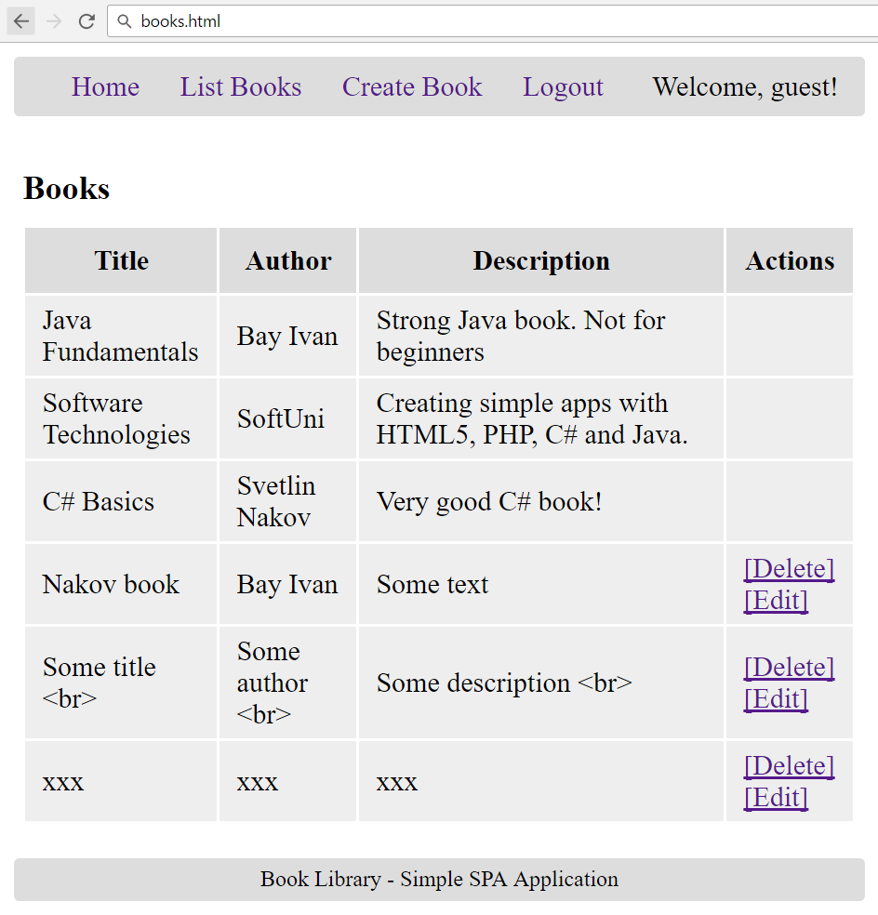
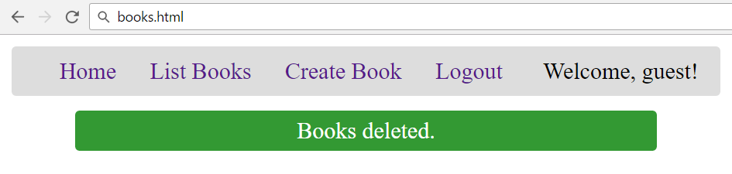
Delete Book Screen

Slide 14
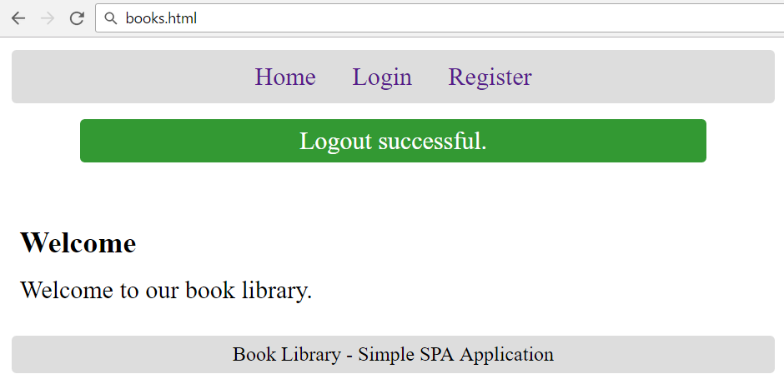
Logout Screen

Slide 15
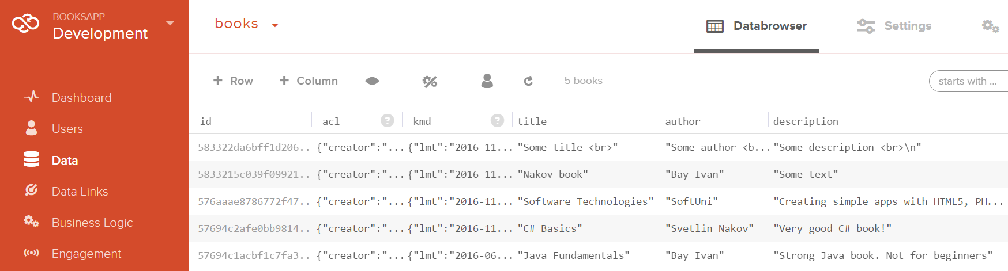
The Kinvey-Based Back-End
Users and Books Collections

Slide 16
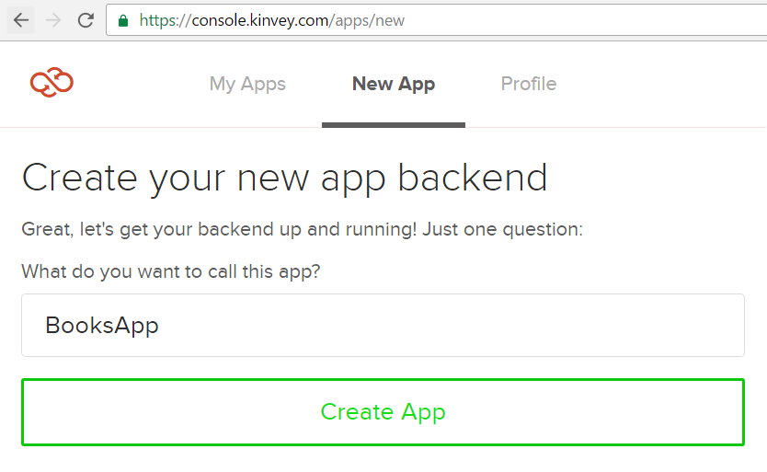
Create Kinvey App

Slide 17
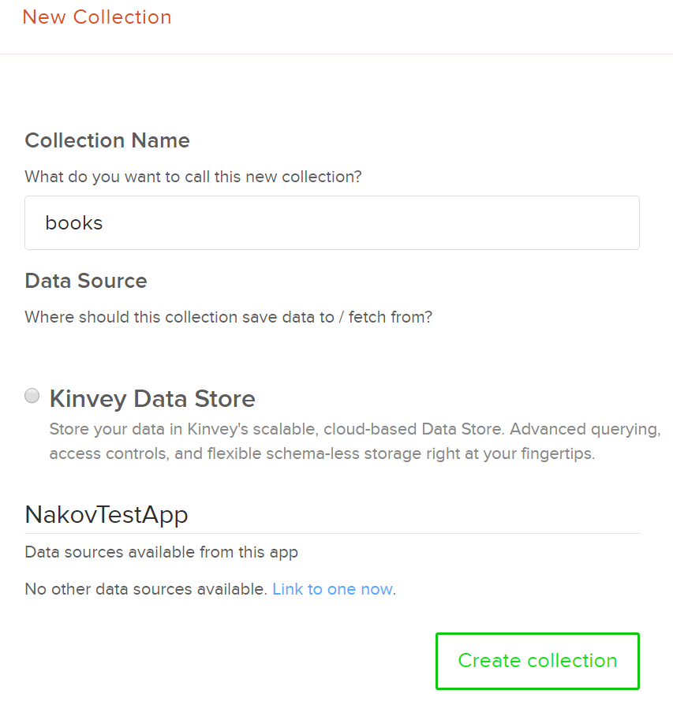
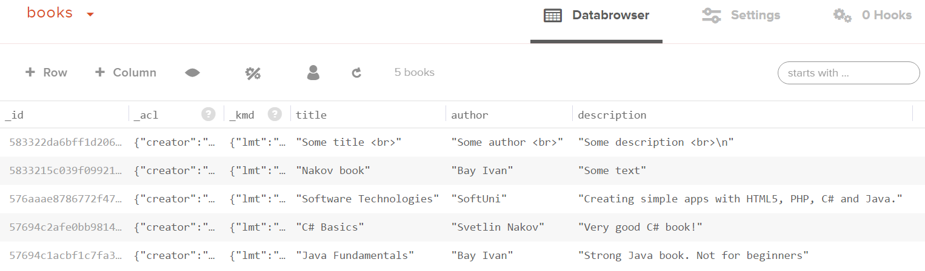
Create Books Collection
Create a collection "books"
Add a few books
Columns: title + author + description

Slide 18
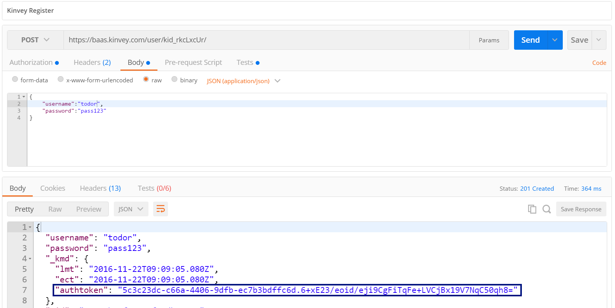
Test the Kinvey Back-End: Register User
POST
https://baas.kinvey.com/user/{app_id}/
Authorization: Basic base64(app_id:app_secret)
{"username":"todor", "password":"pass123"}

Slide 19
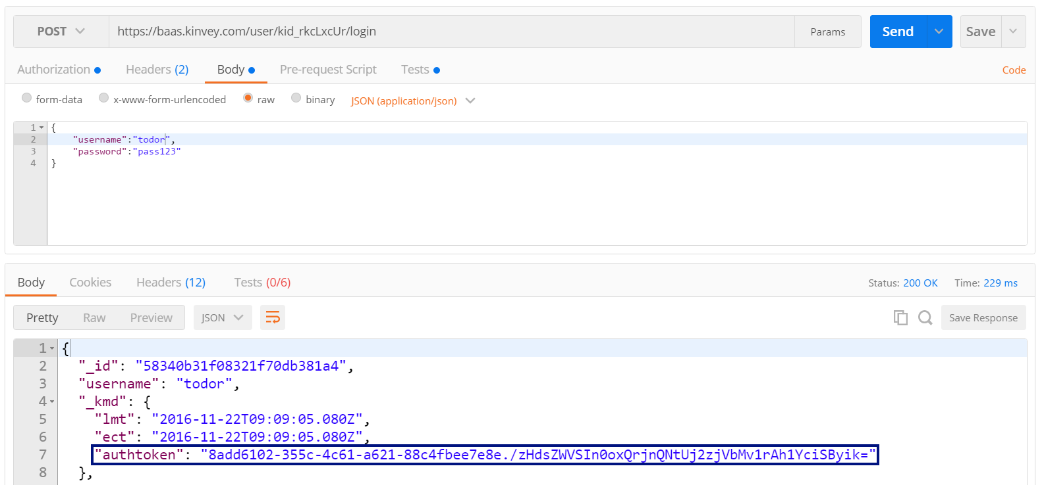
Test the Kinvey Back-End: Login User
POST
https://baas.kinvey.com/user/{app_id}/login
Authorization: Basic base64(app_id:app_secret)
{"username":"todor", "password":"pass123"}

Slide 20
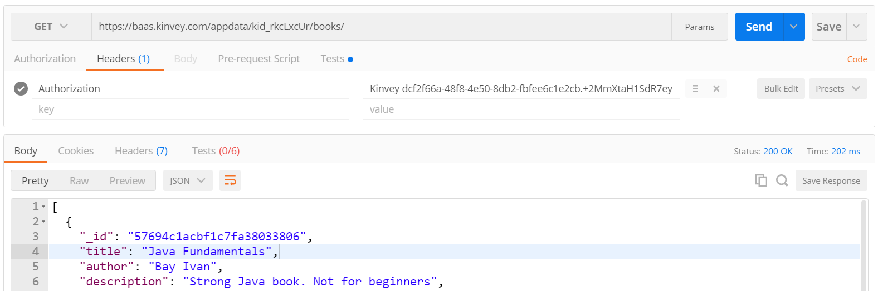
Test the Kinvey Back-End: List All Books
GET
https://baas.kinvey.com/appdata/{app_id}/books
Authorization: Kinvey authtoken

Slide 21
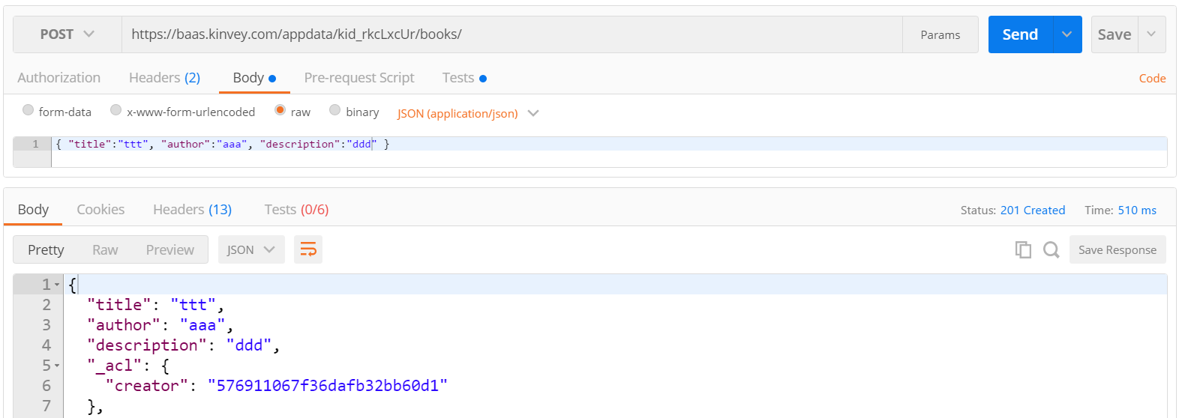
Test the Kinvey Back-End: Create New Book
POST
https://baas.kinvey.com/appdata/{app_id}/books
Authorization: Kinvey authtoken
{ "title":"ttt", "author":"aaa", "description":"ddd" }

Slide 22
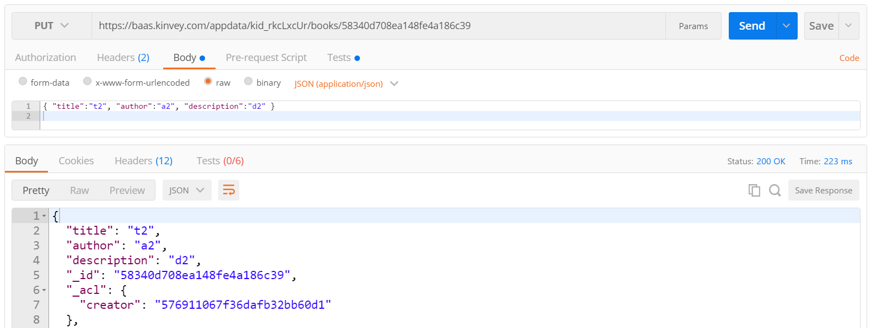
Test the Kinvey Back-End: Edit Book
PUT
https://baas.kinvey.com/appdata/{app_id}/books/{id}
Authorization: Kinvey authtoken
{ "title":"t2", "author":"a2", "description":"d2" }

Slide 23
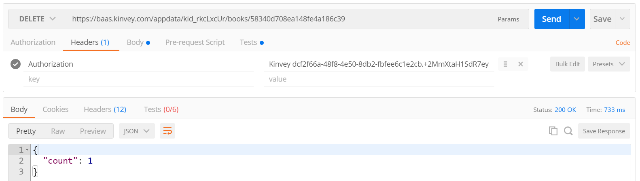
Test the Kinvey Back-End: Delete Book
DELETE
https://baas.kinvey.com/appdata/{app_id}/books/{id}
Authorization: Kinvey authtoken

Slide 24
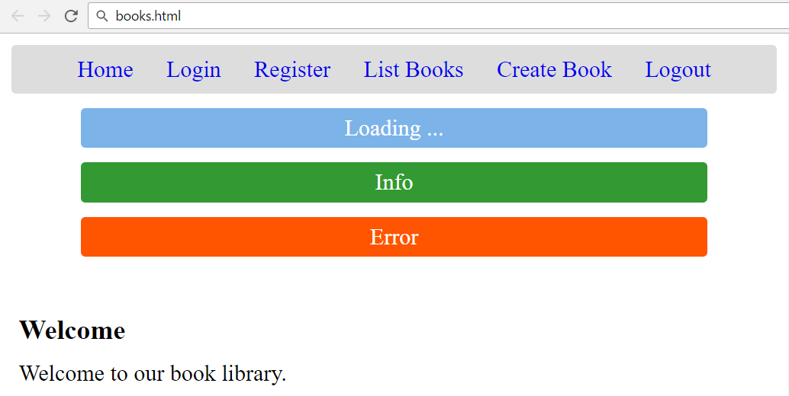
Create the Application Skeleton
HTML, CSS, Views, Forms, Info Boxes

Slide 25
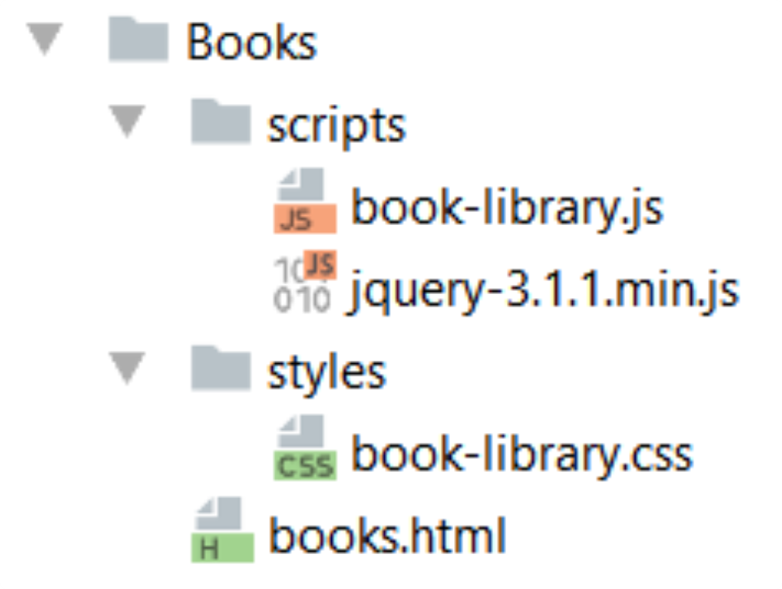
Create the Project Structure

Slide 26
Start with the HTML Page: books.html
<!DOCTYPE html>
<html>
<head>
<title>Book Library</title>
<script src="scripts/jquery-3.1.1.min.js"></script>
<script src="scripts/book-library.js"></script>
<link rel="stylesheet" type="text/css"
href="styles/book-library.css" />
</head>
<body>…</body>
</html>

Slide 27
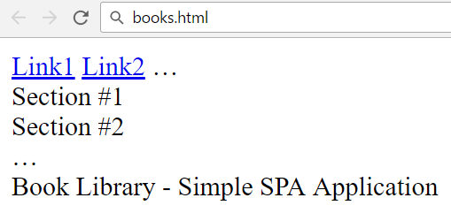
HTML Body Structure
<body onload="startApp()">
<header id="menu">
<a href="#" id="link1">Link1</a>
<a href="#" id="link2">Link2</a>
…
</header>
<main>
<section id="view1">Section #1</section>
<section id="view2">Section #2</section>
…
</main>
<footer>Book Library - Simple SPA Application</footer>
</body>

Slide 28
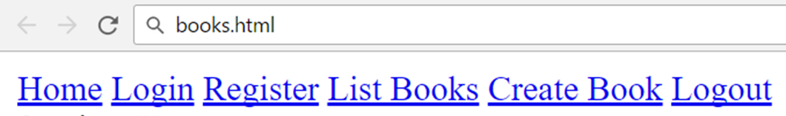
Main Navigation (Menu)
<header id="menu">
<a href="#" id="linkHome">Home</a>
<a href="#" id="linkLogin">Login</a>
<a href="#" id="linkRegister">Register</a>
<a href="#" id="linkListBooks">List Books</a>
<a href="#" id="linkCreateBook">Create Book</a>
<a href="#" id="linkLogout">Logout</a>
<span id="loggedInUser"></span>
</header>

Slide 29
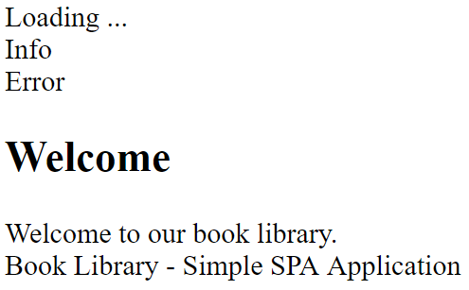
App Sections
<section id="loadingBox">Loading ...</section>
<section id="infoBox">Info</section>
<section id="errorBox">Error</section>
<section id="viewHome">
<h1>Welcome</h1>
Welcome to our book library.
</section>

Slide 30
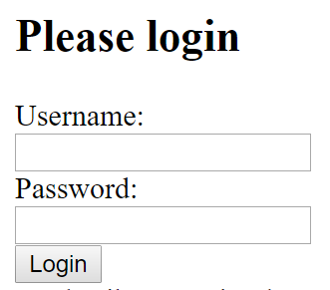
Login View
<section id="viewLogin">
<h1>Please login</h1>
<form id="formLogin">
<div>Username:</div>
<div><input type="text" name=
"username" required /></div>
<div>Password:</div>
<div><input type="password"
name="passwd" required /></div>
<div><input type="submit" value="Login" /></div>
</form>
</section>

Slide 31
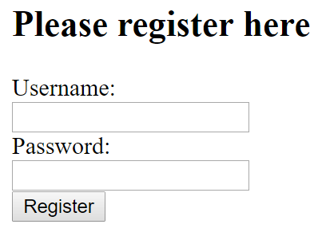
Register View
<section id="viewRegister">
<h1>Please register here</h1>
<form id="formRegister">
<div>Username:</div>
<div><input type="text" name=
"username" required /></div>
<div>Password:</div>
<div><input type="password"
name="passwd" required /></div>
<div><input type="submit" value="Register" /></div>
</form>
</section>

Slide 32
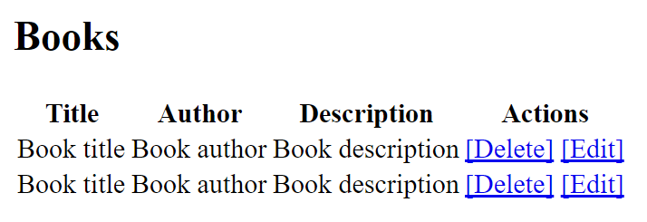
Books View
<section id="viewBooks">
<h1>Books</h1>
<div id="books">
<table>
<tr>
<th>Title</th>
<th>Author</th>
<th>Description</th>
<th>Actions</th>
</tr>
<tr>
<td>Book title</td>
<td>Book author</td>
<td>Book description</td>
<td>
<a href="#">[Delete]</a>
<a href="#">[Edit]</a>
</td>
</tr>
…
</table>
</div>
</section>

Slide 33
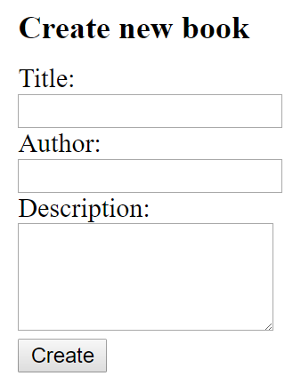
Create Book View
<section id="viewCreateBook">
<h1>Create new book</h1>
<form id="formCreateBook">
<div>Title:</div>
<div><input type="text" name="title" required /></div>
<div>Author:</div>
<div><input type="text" name="author" required /></div>
<div>Description:</div>
<div><textarea name="descr"
rows="10" required></textarea></div>
<div><input type="submit" value="Create" /></div>
</form>
</section>

Slide 34
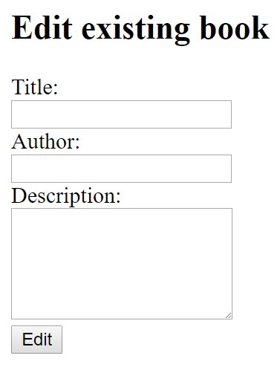
Edit Book View
<section id="viewEditBook">
<h1>Edit existing book</h1>
<form id="formEditBook">
<div><input type="hidden" name="id" required /></div>
<div>Title:</div>
<div><input type="text" name="title" required /></div>
<div>Author:</div>
<div><input type="text" name="author" required /></div>
<div>Description:</div>
<div><textarea name="descr" rows="10"
required></textarea></div>
<div><input type="submit value="Edit" /></div>
</form>
</section>

Slide 35
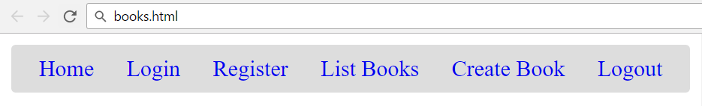
CSS: Style the Navigation Bar (Menus)
#menu {
background: #DDD;
text-align: center;
padding: 5px;
line-height: 1.5;
border-radius: 3px;
overflow: auto;
}
#menu>#loggedInUser {
float: right;
margin-right: 10px;
}
#menu a {
text-decoration: none;
padding: 5px 10px;
border-radius: 5px;
}
#menu a:hover {
background: #BBB;
}

Slide 36
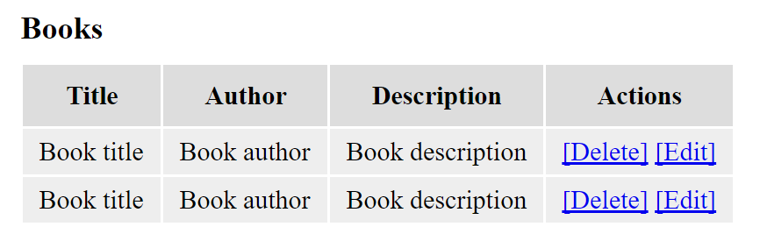
Style the Sections and Tables
main > section {
display: none;
padding: 20px 5px;
}
section h1 {
margin: 10px 0px;
font-size: 1.2em;
}
table th {
background: #DDD;
padding: 10px;
}
table td {
padding: 5px 10px;
background: #EEE;
}

Slide 37
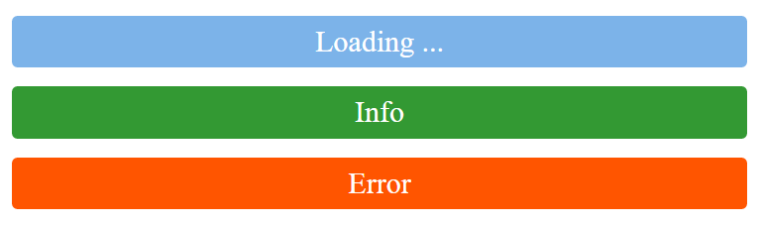
Style the Loading / Info / Error Boxes
#infoBox, #errorBox, #loadingBox {
width: 80%;
margin: 10px auto;
color: white;
text-align: center;
padding: 5px;
border-radius: 3px;
}
#loadingBox {
background: #7CB3E9;
}
#infoBox {
background: #393;
}
#errorBox {
background: #F50;
}

Slide 38

Style the App Footer
footer {
background: #DDD;
padding: 5px 10px;
font-size: 0.8em;
text-align: center;
border-radius: 3px;
}

Slide 39
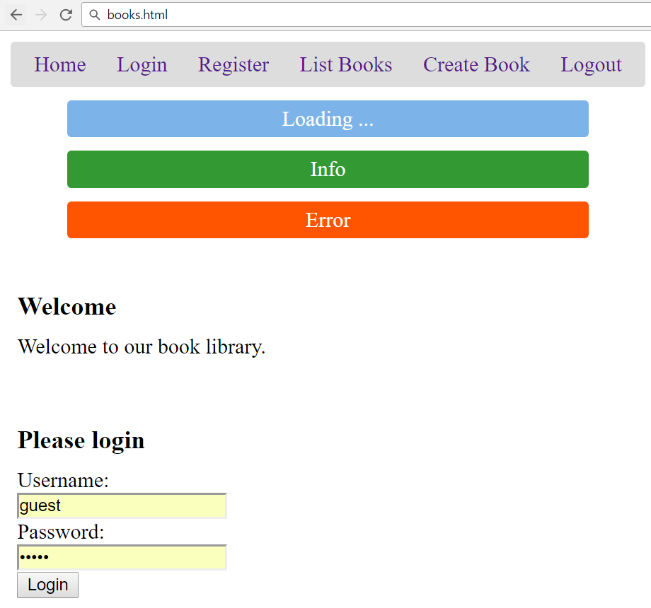
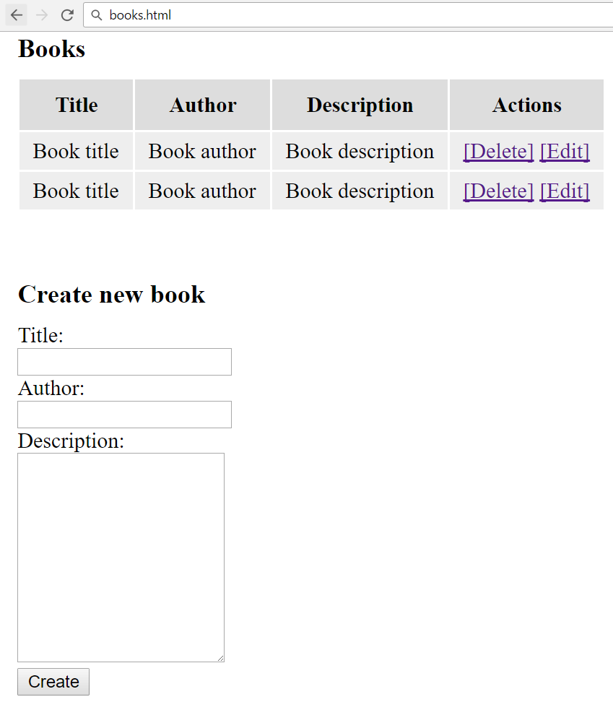
Test the App Skeleton

Slide 40
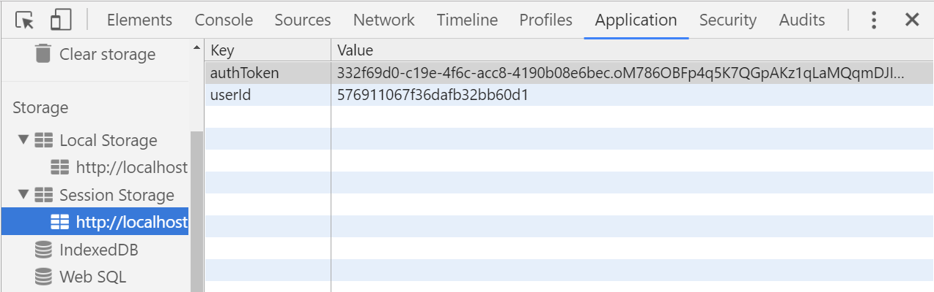




Session / Local Storage

Slide 41
Session / Local Storage – Overview
Session storage holds key / value pairs in the browser session
All data is lost when the browser is closed, survives page reloads
// Save data to sessionStorage
sessionStorage.setItem('username', 'maria');
// Get saved data from sessionStorage
let currentUser = sessionStorage.getItem('username');
// Remove all saved data from sessionStorage
sessionStorage.clear();

Slide 42
Local Storage
Local storage holds key / value pairs in the browser
Data survives for long time, until manually deleted
Each origin (site location) has its own storage
https://softuni.bg holds different data than https://google.com
// Save data to localStorage
localStorage.setItem('language', 'en');
// Get saved data from localStorage
let lang = localStorage.getItem('languuage');

Slide 43
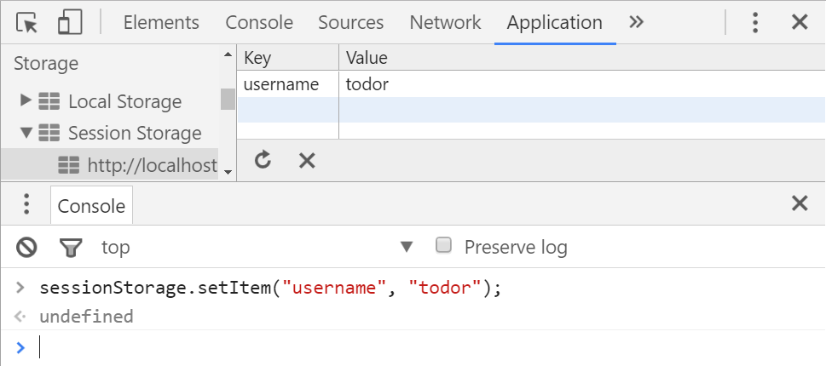
Play with the Session Storage

Slide 44
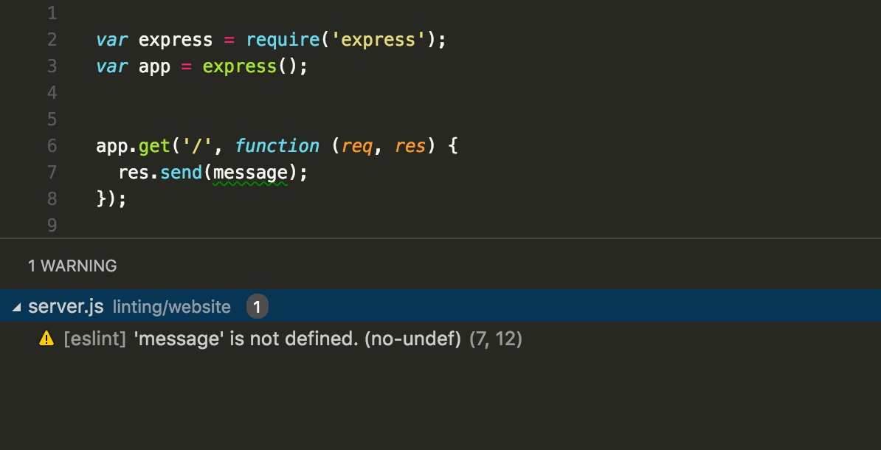


App Code Structure

Slide 45
App Structure
book-library.js
function startApp() {
sessionStorage.clear(); // Clear user auth data
showHideMenuLinks();
showView('viewHome');
// Bind the navigation menu links
$("#linkHome").click(showHomeView);
…
// Bind the form submit actions
$("#formLogin").submit(loginUser);
…
$("form").submit(function(e) { e.preventDefault() });
}
Handle form.submit() not button.click(). Otherwise validation fill be bypassed.
Disable default submit for all forms

Slide 46
Bind the Navigation Links
// Bind the navigation menu links
$("#linkHome").click(showHomeView);
$("#linkLogin").click(showLoginView);
$("#linkRegister").click(showRegisterView);
$("#linkListBooks").click(listBooks);
$("#linkCreateBook").click(showCreateBookView);
$("#linkLogout").click(logoutUser);

Slide 47
Bind the Form Submit Actions
// Bind the form submit buttons
$("#buttonLoginUser").click(loginUser);
$("#buttonRegisterUser").click(registerUser);
$("#buttonCreateBook").click(createBook);
$("#buttonEditBook").click(editBook);

Slide 48
Bind Info Boxes
// Bind the info / error boxes: hide on click
$("#infoBox, #errorBox").click(function() {
$(this).fadeOut();
});
// Attach AJAX "loading" event listener
$(document).on({
ajaxStart: function() { $("#loadingBox").show() },
ajaxStop: function() { $("#loadingBox").hide() }
});

Slide 49
Implement a Simple Navigation System
function showHideMenuLinks() {
$("#linkHome").show();
if (sessionStorage.getItem('authToken')) {
// We have logged in user
$("#linkLogin").hide();
$("#linkRegister").hide();
$("#linkListBooks").show();
$("#linkCreateBook").show();
$("#linkLogout").show();

Slide 50
Implement a Simple Navigation System (2)
} else {
// No logged in user
$("#linkLogin").show();
$("#linkRegister").show();
$("#linkListBooks").hide();
$("#linkCreateBook").hide();
$("#linkLogout").hide();
}
}

Slide 51
Implement a Simple Navigation System (3)
function showView(viewName) {
// Hide all views and show the selected view only
$('main > section').hide();
$('#' + viewName).show();
}
function showHomeView() {
showView('viewHome');
}

Slide 52
Implement a Simple Navigation System (4)
function showLoginView() {
showView('viewLogin');
$('#formLogin').trigger('reset');
}
function showRegisterView() {
$('#formRegister').trigger('reset');
showView('viewRegister');
}

Slide 53
Implement a Simple Navigation System (5)
function showCreateBookView() {
$('#formCreateBook').trigger('reset');
showView('viewCreateBook');
}
function loginUser() { // TODO }
function registerUser() { // TODO }
function logoutUser() { // TODO }

Slide 54
Implement a Simple Navigation System (6)
function listBooks() {
// TODO: to be implemented later
}
function createBook() { // TODO }
function editBook() { // TODO }
function deleteBook() { // TODO }

Slide 55
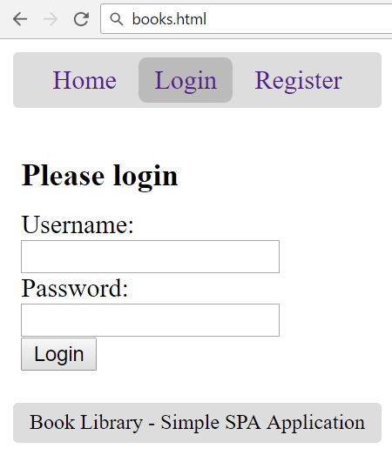
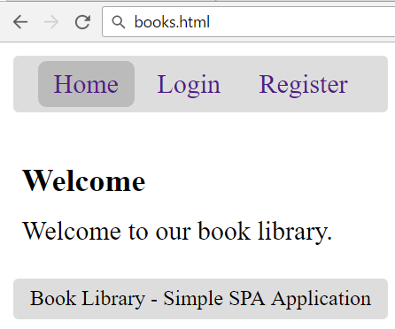
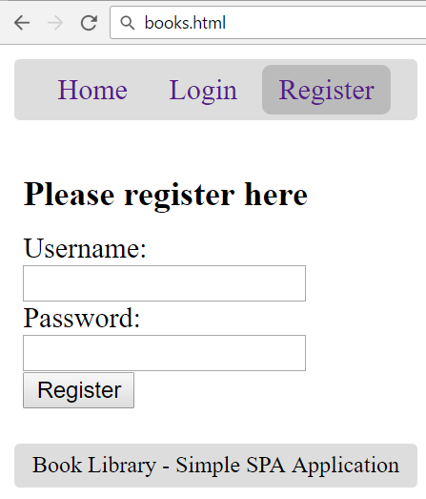
Test the App Navigation

Slide 56
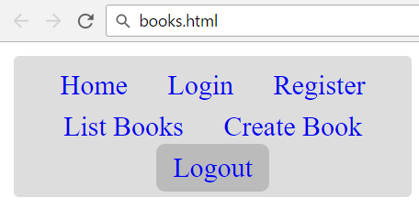
Login / Register / Logout
User Management with Kinvey

Slide 57
App Constants
const kinveyBaseUrl = "https://baas.kinvey.com/";
const kinveyAppKey = "kid_rkcLxcUr";
const kinveyAppSecret =
"e234a245b3864b2eb7ee41e19b8ca4e5";
const kinveyAppAuthHeaders = {
'Authorization': "Basic " +
btoa(kinveyAppKey + ":" + kinveyAppSecret),
};

Slide 58
User Registration: AJAX Request
function registerUser() {
let userData = {
username: $('#formRegister input[name=username]').val(),
password: $('#formRegister input[name=passwd]').val()
};
$.ajax({
method: "POST",
url: kinveyBaseUrl + "user/" + kinveyAppKey + "/",
headers: kinveyAppAuthHeaders,
data: userData,
success: registerSuccess,
error: handleAjaxError
});

Slide 59
User Registration: After AJAX Request
function registerUser() {
…
function registerSuccess(userInfo) {
saveAuthInSession(userInfo);
showHideMenuLinks();
listBooks();
showInfo('User registration successful.');
}
}

Slide 60
Remember User Authentication Data
function saveAuthInSession(userInfo) {
let userAuth = userInfo._kmd.authtoken;
sessionStorage.setItem('authToken', userAuth);
let userId = userInfo._id;
sessionStorage.setItem('userId', userId);
let username = userInfo.username;
$('#loggedInUser').text(
"Welcome, " + username + "!");
}

Slide 61
Handle AJAX Errors: Show the Error Box
function handleAjaxError(response) {
let errorMsg = JSON.stringify(response);
if (response.readyState === 0)
errorMsg = "Cannot connect due to network error.";
if (response.responseJSON &&
response.responseJSON.description)
errorMsg = response.responseJSON.description;
showError(errorMsg);
}

Slide 62
Show Info / Error Message
function showInfo(message) {
$('#infoBox').text(message);
$('#infoBox').show();
setTimeout(function() {
$('#infoBox').fadeOut();
}, 3000);
}
function showError(errorMsg) {
$('#errorBox').text("Error: " + errorMsg);
$('#errorBox').show();
}

Slide 63
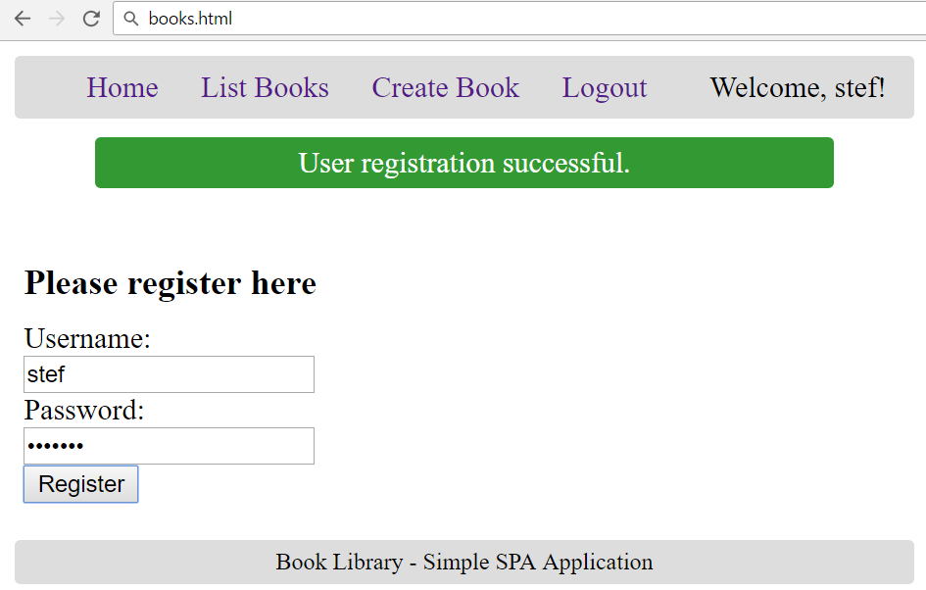
Test the User Registration: Success

Slide 64
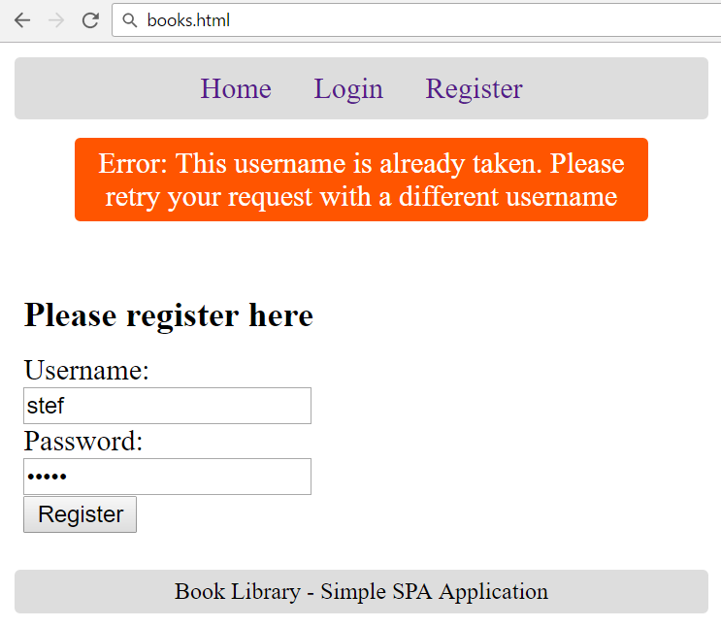
Test the User Registration: Error

Slide 65
User Login: AJAX Request
function loginUser() {
let userData = {
username: $('#formLogin input[name=username]').val(),
password: $('#formLogin input[name=passwd]').val()
};
$.ajax({
method: "POST",
url: kinveyBaseUrl + "user/" + kinveyAppKey + "/login",
headers: kinveyAppAuthHeaders,
data: userData,
success: loginSuccess,
error: handleAjaxError
});

Slide 66
User Login: After AJAX Request
function loginUser() {
…
function loginSuccess(userInfo) {
saveAuthInSession(userInfo);
showHideMenuLinks();
listBooks();
showInfo('Login successful.');
}
}

Slide 67
User Logout
function logoutUser() {
sessionStorage.clear();
$('#loggedInUser').text("");
showHideMenuLinks();
showView('viewHome');
showInfo('Logout successful.');
}

Slide 68

Implementing CRUD Operations
List / Create / Delete / Edit

Slide 69
List Books: AJAX Request
function listBooks() {
$('#books').empty();
showView('viewBooks');
$.ajax({
method: "GET",
url: kinveyBaseUrl + "appdata/" + kinveyAppKey + "/books",
headers: getKinveyUserAuthHeaders(),
success: loadBooksSuccess,
error: handleAjaxError
});
function loadBooksSuccess(books) { … }
}

Slide 70
Kinvey Authorization Headers
function getKinveyUserAuthHeaders() {
return {
'Authorization': "Kinvey " +
sessionStorage.getItem('authToken'),
};
}

Slide 71
List Books: After AJAX Request
function loadBooksSuccess(books) {
showInfo('Books loaded.');
if (books.length == 0) {
$('#books').text('No books in the library.');
} else {
let booksTable = $('<table>')
.append($('<tr>').append(
'<th>Title</th><th>Author</th>',
'<th>Description</th><th>Actions</th>'));
for (let book of books)
appendBookRow(book, booksTable);
$('#books').append(booksTable);
}
}

Slide 72
Display Single Book Line
function appendBookRow(book, booksTable) {
let links = [];
// TODO: action links will come later
booksTable.append($('<tr>').append(
$('<td>').text(book.title),
$('<td>').text(book.author),
$('<td>').text(book.description),
$('<td>').append(links)
));
}

Slide 73
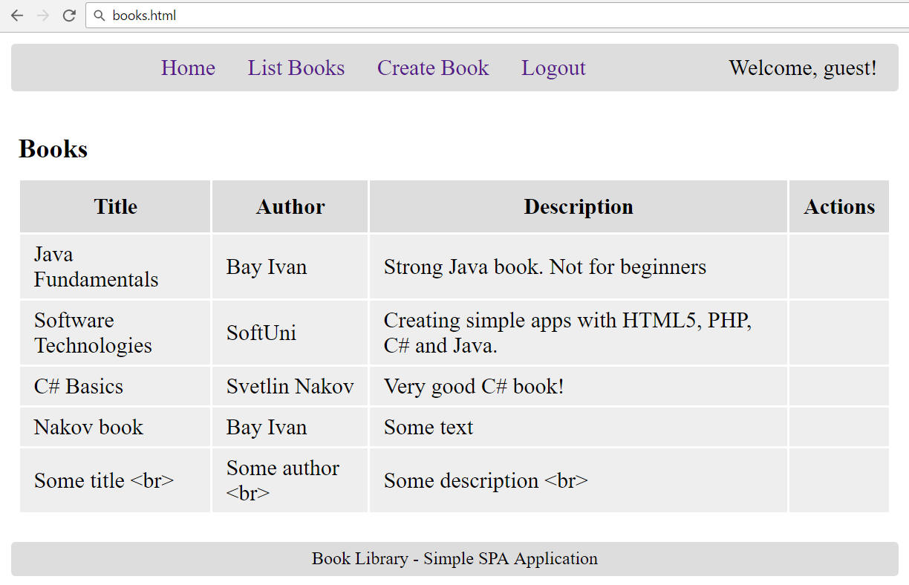
Test: List Books

Slide 74
Create New Book: AJAX Request
function createBook() {
let bookData = {
title: $('#formCreateBook input[name=title]').val(),
author: $('#formCreateBook input[name=author]').val(),
description: $('#formCreateBook textarea[name=descr]').val()
};
$.ajax({
method: "POST",
url: kinveyBaseUrl + "appdata/" + kinveyAppKey + "/books",
headers: getKinveyUserAuthHeaders(),
data: bookData,
success: createBookSuccess,
error: handleAjaxError
});

Slide 75
Create New Book: After AJAX Request
function createBookSuccess(response) {
listBooks();
showInfo('Book created.');
}
}

Slide 76
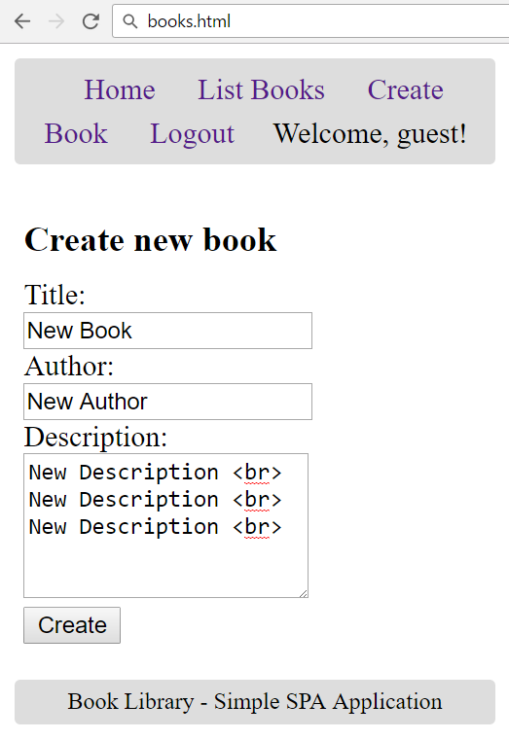
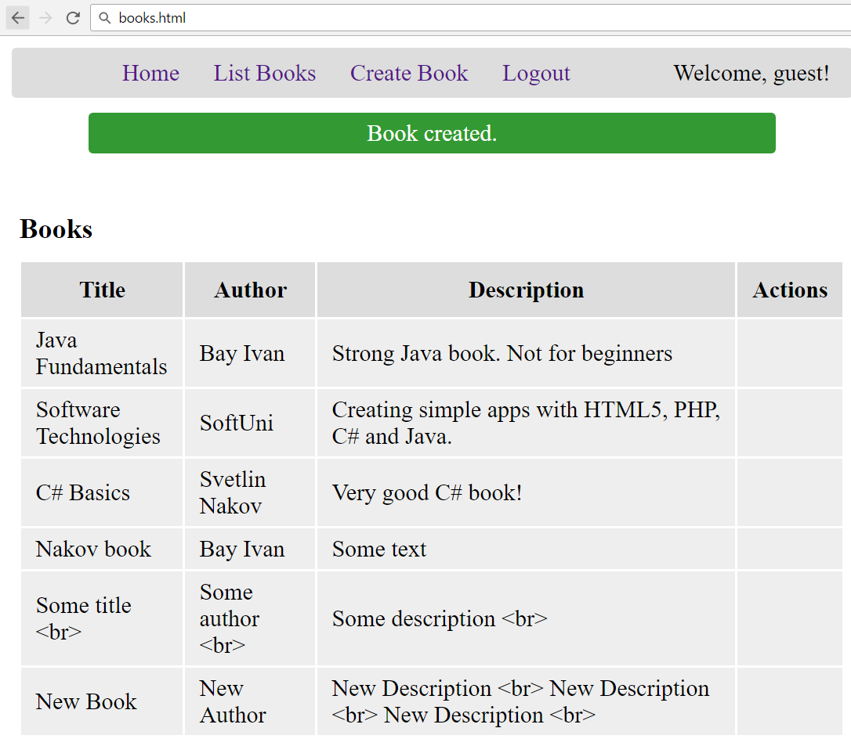
Test: Create New Book

Slide 77
Display Edit / Delete Links
function appendBookRow(book, booksTable) {
let links = [];
if (book._acl.creator == sessionStorage['userId']) {
let deleteLink = $('<a href="#">[Delete]</a>')
.click(deleteBook.bind(this, book));
let editLink = $('<a href="#">[Edit]</a>')
.click(loadBookForEdit.bind(this, book));
links = [deleteLink, ' ', editLink];
}
booksTable.append($('<tr>')
.append( … cells & links ));
}
Bind the event handler with the current book

Slide 78
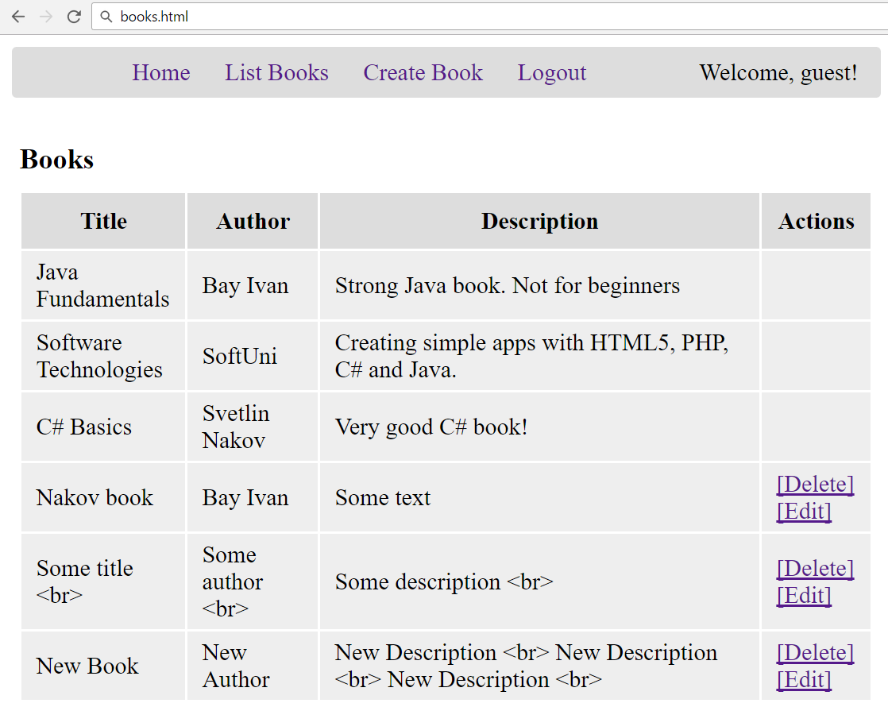
Test: Display Edit / Delete Links

Slide 79
Delete Book: AJAX Request
function deleteBook(book) {
$.ajax({
method: "DELETE",
url: kinveyBookUrl = kinveyBaseUrl + "appdata/" +
kinveyAppKey + "/books/" + book._id,
headers: getKinveyUserAuthHeaders(),
success: deleteBookSuccess,
error: handleAjaxError
});
function deleteBookSuccess(response) {
listBooks();
showInfo('Book deleted.');
}
}

Slide 80


Test: Delete Book

Slide 81
Load Book for Edit: AJAX Request
function loadBookForEdit(book) {
$.ajax({
method: "GET",
url: kinveyBookUrl = kinveyBaseUrl + "appdata/" +
kinveyAppKey + "/books/" + book._id,
headers: getKinveyUserAuthHeaders(),
success: loadBookForEditSuccess,
error: handleAjaxError
});
…

Slide 82
Load Book for Edit: After AJAX Request
function loadBookForEditSuccess(book) {
$('#formEditBook input[name=id]').val(book._id);
$('#formEditBook input[name=title]').val(book.title);
$('#formEditBook input[name=author]')
.val(book.author);
$('#formEditBook textarea[name=descr]')
.val(book.description);
showView('viewEditBook');
}
}

Slide 83
Edit Book: AJAX Request
function editBook() {
let bookData = {
title: $('#formEditBook input[name=title]').val(),
author: $('#formEditBook input[name=author]').val(),
description:
$('#formEditBook textarea[name=descr]').val()
};
$.ajax({
method: "PUT",
url: kinveyBaseUrl + "appdata/" + kinveyAppKey +
"/books/" + $('#formEditBook input[name=id]').val(),

Slide 84
Edit Book: AJAX Request (2)
headers: getKinveyUserAuthHeaders(),
data: bookData,
success: editBookSuccess,
error: handleAjaxError
});
function editBookSuccess(response) {
listBooks();
showInfo('Book edited.');
}
}

Slide 85



Test: Edit Book

Slide 86

Practice: Create "Book Library" App
Live Exercises in Class (Lab)

Slide 87


Summary
Single Page Apps (SPA) are built with HTML5, AJAX and REST + some back-end
App navigation may consist of DOM elements, which are shown / hidden
Login / register / logout is typically implemented with sessionStorage
CRUD operations is typically send AJAX request and render the results after that
Edit / delete may require to load the item first, then edit it / confirm delete, then post changes

Slide 88







SPA with AJAX REST and Kinvey
https://softuni.bg/courses/

Slide 89
License
This course (slides, examples, demos, videos, homework, etc.) is licensed under the "Creative Commons Attribution-NonCommercial-ShareAlike 4.0 International" license

Slide 90





Free Trainings @ Software University
Software University Foundation – softuni.org
Software University – High-Quality Education, Profession and Job for Software Developers
softuni.bg
Software University @ Facebook
facebook.com/SoftwareUniversity
Software University Forums
forum.softuni.bg

